Slide 1
CEIS295 Module 5
Speed Test for Searching Algorithms

Slide 2
Rubric
Activity | Requirement(s) | Points
Develop Code to Use Objects with the Sort Routines | Client.py Code | 10
Develop Code to Test the Searching Algorithm Speeds | SearchingActualSpeed.py code | 20
Screenshot to Demonstrate Working Application | Screenshot of running application showing your name and the current date | 10
Excel Table Showing Relevant Speeds | Table showing amount of time for each search routine | 10

Slide 3
Client.py Python Code
Code:
# Name: Kyrenia Ailen Andrade Avila
# Date: 08/07/2022
class Client:
def __init__ (self, client_id=0, first_name="Unknown", last_name="Unknown", phone="Unknown", email="Unknown"):
self.__client_id = client_id
self.__first_name = first_name
self.__last_name = last_name
self.__phone = phone
self.__email = email
# classes that compare objects must implement __eq__ and __lt__ methods
# __eq__ means "equals" and it must return a boolean
# __lt__ means "less than" and it must return a boolean
# __le__ means "less than or equal to" and it must return a boolean
def __lt__ (self, other):
return self.__client_id < other.__client_id
def __le__ (self, other):
return self.__client_id <= other.__client_id
def __eq__(self, other):
return self.__client_id == other.__client_id
# __str__ method is automatically called when you print the object
def __str__(self):
return str(self.__client_id) + ", " + self.__last_name + ", " + self.__first_name
# getters and setters
# you normally validate them, but we're not validating anything here
# client_id
def get_client_id (self):
return self.__client_id
def set_client_id (self, client_id):
set.__client_id = client_id
#first_name
def get_first_name (self):
return self.__first_name
def set_first_name (self, first_name):
set.__first_name = first_name
#last_name
def get_last_name (self):
return self.__last_name
def set_last_name (self, last_name):
set.__last_name = last_name
#phone
def get_phone (self):
return self.__phone
def set_phone (self, phone):
set.__phone = phone
#email
def get_email (self):
return self.__email
def set_email (self, email):
set.__email = email
Paste your Client.py Python code in the box on the right side.
Include the following attributes and behaviors:
Attributes
__client_id
__first_name
__last_name
__phone
__email
Behaviors
__lt__
__eq__
__str__
Getters and Setters

Slide 4
SearchingActualSpeed.py Python Code
Code:
# Name: Kyrenia Ailen Andrade Avila
# Date: 08/07/2022
from LinearSearch import LinearSearch
from BinarySearch import BinarySearch
from Quicksort import Quicksort
from Client import Client
from datetime import date
import random #use to generate random numbers
import time #use this library to time the code executions
import sys #use to exit the application early
# display name and date in output
print("Name:", "Kyrenia Ailen Andrade Avila")
print("Date:", date.today())
print()
#input_file_name = 'ClientData100.csv'
#input_file_name = 'ClientData1000.csv'
#input_file_name = 'ClientData10000.csv'
input_file_name = 'ClientData100000.csv'
# create a list
clients = []
# read the records from the ClientData.csv file
# into Client objects and place the Client objects into the list
with open(input_file_name) as infile:
for line in infile:
#split the line based on the commas
s = line.split(',')
client_id = int( s[0 ]) #convert the default string to an int
f_name = s[1]
l_name = s[2]
phone = s[3]
email = s[4]
# create a client object using data from the file
clt = Client(client_id, f_name, l_name, phone, email)
# add client object to the list
clients.append(clt)
# how many client objects do we have
num_records = len(clients)
# Scenario: Search for 1000 records from a data file
section_title = "Scenario: Searching Through" + str(num_records) + " Records"
print(section_title)
print("-" * len(section_title))
# MUST SORT THE DATA TO DO A BINARY SEARCH
Quicksort.sort(clients)
#start and end record numbers
start_record = 100001
end_record = start_record + num_records
#how long does it take to sort the records?
start_time = time.time()
# how long does it take to do a random linear search through the records?
for i in range (1000):
client_id = random.randint(start_record, end_record)
clt = Client(client_id)
result = BinarySearch.search(clients, clt)
if result is None:
print(clt, "was not found.")
else:
print(result)
end_time = time.time()
total_time = end_time - start_time
print("Seconds to linear search for 1000 random records: {:.6f}".format(total_time))
Paste your Python code. Include the following processes:
Read records into application
Test the following searching algorithm speeds:
Linear Search
Binary Search
Test these two algorithms against different size datasets
100 records
1,000 records
10,000 records
100,000 records

Slide 5
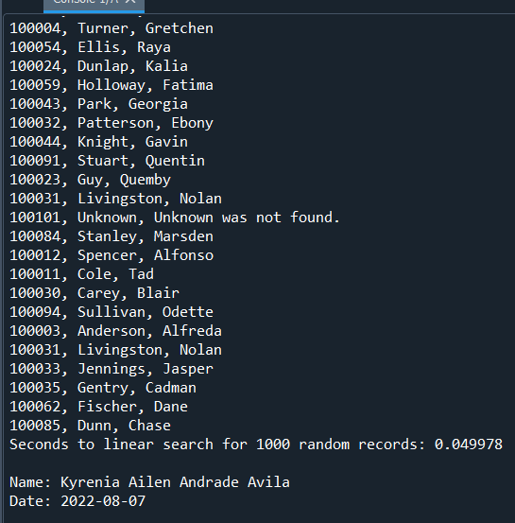
Screenshot of Running Code
Run your SearchingSpeed.py code and take a screenshot of the output. The output screenshot must show your name and the date to be accepted.
Please note. We are looking to avoid plagiarism. As a result, if the running code does not show your name and the current date, then this Course Project will be given a zero until you submit a PowerPoint that shows your name and the current date in the output screenshot.

Slide 6
Table of Searching Speeds
Create a table showing the time that it takes for the following searching algorithms using different data sizes:
Linear Search
Binary Search

